Slide 1
Case study Continuous performance testing with machine learning

Slide 2
TaaS: Performance testing
Description:
Some huge Icelandic bank, had a request for checking their application performance during their migration from archaic technology to .NET services. Application is to be integrated with a lot of third party system and consist of three layers. The test team was responsible not only for searching bugs and creating performance testing framework, but also for teaching client for performance testing skills
Challenges:
No documented knowledge about the system
No special environment and no any test data
No knowledge and expectation about performance testing
No accesses
No monitoring system

Slide 3
TaaS: Performance testing
Platforms / Technologies:
Java, Selenium + browsermobproxy + harstorage, Jmeter, R + Shiny

Slide 4
TaaS: Performance testing
Approach:
Implementation of structured performance testing life cycle
Integration of performance testing in continuous integration
Automation of repetitive performance testing pipeline (smoke, load, scalability, stability, error detection)
Maximal metric measurement with afterward analysis
Maximal automatize of routine activities (data preparation and first analysis)
Tight communication with onshore development team and customer teams
Scope:

Slide 5
Project Timeline
Initiation
Define critical business values and goals
Information gathering
Manual testing
Result Analysis & Reporting
Recommendations how to fix performance issues
Project schedule
Design check-lists
Test Strategy
Infrastructure analysis
Performance requirements analysis
Summary report
Script generating
Manual preparation
Manual run and bottleneck searching
Automated run
CI (TFS + teamcity)
Connect monitoring
Automatization routine operation
Report generation
Jmeter monitoring tool
Data preparation
Static report
Web-report
Data cleaning
Data saving
Data wrangling
Dynatrace api
Ckeck_mk monitoring
Distributed run
Configuring test plan from CI tool
CI pipeline
Automatized comparation with requirements
Define metrics for comparations
Automatized requirement generation
Semiautomatic bottleneck detection
Anomaly detection
Context depending
Arima forecasting expected results
Cluster analysis
Correlation heatmaps
Moving median
Robust statistic
Defined requirements

Slide 6
Project Timeline in real life
Initiation
Information gathering
Manual testing
Result Analysis & Reporting
Automated run
Connect monitoring
Automatization routine operation
Report generation
Automatized comparation with requirements
Automatized requirement generation
Semiautomatic bottleneck detection
Anomaly detection

Slide 7
TaaS: Performance testing
Results:
Performance testing framework
Performance testing CI
Automated analysis
Automated report generation
Semiautomatic bottleneck detection (using ML)
Integration with monitoring system
Deliverables:
Test Strategy is introduced and followed
Overall Test Scope is identified
Performance testing framework (description and documentation)
Scenarios and scripts automated (Smoke, load, scalability, stability)
Customer issues analyzed (application, DB, infrastructure)
Recommendation provided
CI configured
Daily ongoing automated reports and recommendation

Slide 8
Performance team integration
Customer
Itera
Management
Project Manager
Test Automation Engineer
Performance testing Architect
Test Lead 1 FTE
Test Engineers
Test Automation Engineers
Developers
Developers
Monitoring team
Joint team
Tight collaboration

Slide 9
Continuous PT
Report Generation
Machine learning in PT
Recommendation for bottleneck detection
PT fairy fails tales

Slide 10
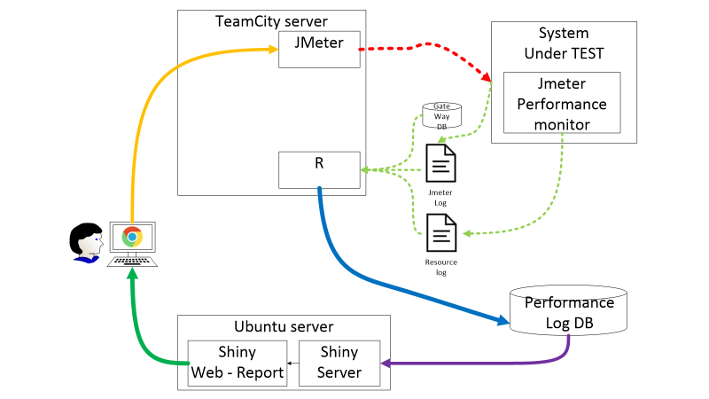

Slide 11
Continuous performance testing

Slide 12
Continuous performance testing – descriptio
User interact and configure everything from CI tool (web-ui)
CI tool interact with all elements via it’s agents and instruments API
Everything possible to configure from CI tool (Load, duration, versions, type of testing, report and log level)
CI tool start load tools and load tools generate necessary load in one agent or distributed load, which also configured from CI tool
CI tool gather all necessary information afterward performance test
CI tool run analytical and report generator scripts
CI tool save all information and logs (raw, cleaned, aggregated) into DB
CI save all aggregated reports into artifacts
User may interact with report tool vi web-ui
Report tool should support filtering, comparing by many parameters (load, date, ifrastructure)

Slide 13
Continuous performance testing
Functional test (pre-commit, integration, functional, GUI tests)
Deployment to performance environment
Save results and generate report
Smoke test (integration, functional tests)
PT: Etalon test
PT: separate test on target load
PT: step separate test to stress load
PT: step combined test to stress load

Slide 14
Performance testing pipeline description
Each steps should based on information from successful previous step
Successful functional tests is precondition for start performance testing (PT takes too much time for idle run)
Smoke test check availability of functionality and make warm up
Smoke tests duration should non be more than minimal time execution (e.g. 5 minutes)
Etalon test gather information about measurements in perfect conditions (e.g. 1 RPS, no more than open connection etc.). Most of comparation will be done with etalon conditions
Separate tests shows how system works without other impact. It gives possibility compare and exclude additional impact in future tests.
Target load gives possibility check system under expected load.
But overload during stress tests gives possibility get overload point and detects systems thresholds
Saving all information gives possibility to detect bottlenecks and not to waste time for rerun all tests

Slide 15
Evolution Continuous performance testing

Slide 16
Evolution Continuous performance testing
Hardcoded scripts
Manual executions
Manual (eye analysis)
Manual checks
Manual report generators
Configured scripts
Configured runs
Automatic executions
Configured tests
Results saving
Automatic results analysis
Automatic report generation
Automatic anomaly detection
Automatic recommendation generation

Slide 18
TaaS: Performance testing
Platforms / Technologies:
Java, Selenium + browsermobproxy + harstorage, Jmeter, R + Shiny
Description:
Some huge Icelandic bank, had a request for checking their application performance during their migration from archaic technology to .NET services. Application is to be integrated with a lot of third party system and consist of three layers. The test team was responsible not only for searching bugs and creating performance testing framework, but also for teaching client for performance testing skills
Challenges:
No documented knowledge about the system
No special environment and no any test data
No knowledge and expectation about performance testing
No accesses
No monitoring system
Results:
Performance testing framework
Performance testing CI
Automated analysis
Automated report generation
Semiautomatic bottleneck detection (using ML)
Integration with monitoring system
Efforts:
1 FTE
09.2016 – now

Slide 19
TaaS: Performance testing
Approach:
Implementation of structured performance testing life cycle
Integration of performance testing in continuous integration
Automation of repetitive performance testing pipeline (smoke, load, scalability, stability, error detection)
Maximal metric measurement with afterward analysis
Maximal automatize of routine activities (data preparation and first analysis)
Tight communication with onshore development team and customer teams
Deliverables:
Test Strategy is introduced and followed
Overall Test Scope is identified
Performance testing framework (description and documentation)
Scenarios and scripts automated (Smoke, load, scalability, stability)
Customer issues analyzed (application, DB, infrastructure)
Recommendation provided
CI configured
Daily ongoing automated reports and recommendation

Slide 20
Continuous PT
Report Generation
Machine learning in PT
Recommendation for bottleneck detection
PT fairy fails tales

Slide 21
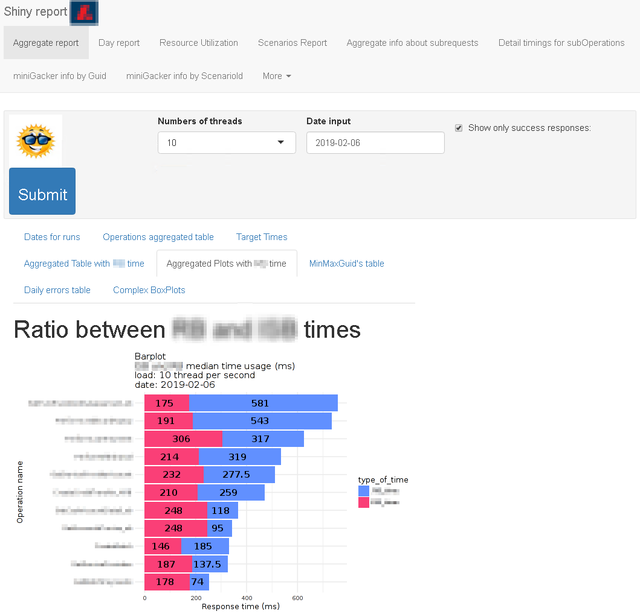
Report generation

Slide 22
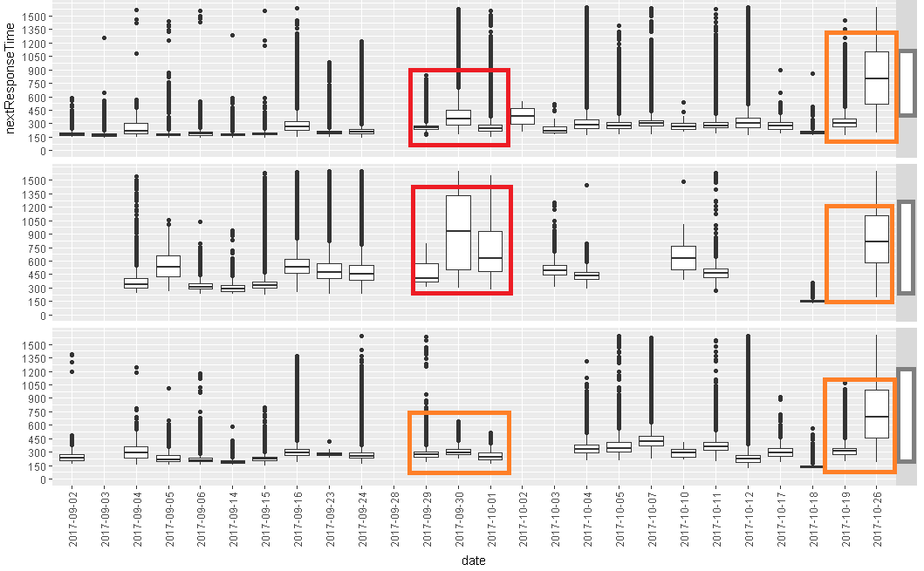
Report generation
date

Slide 23
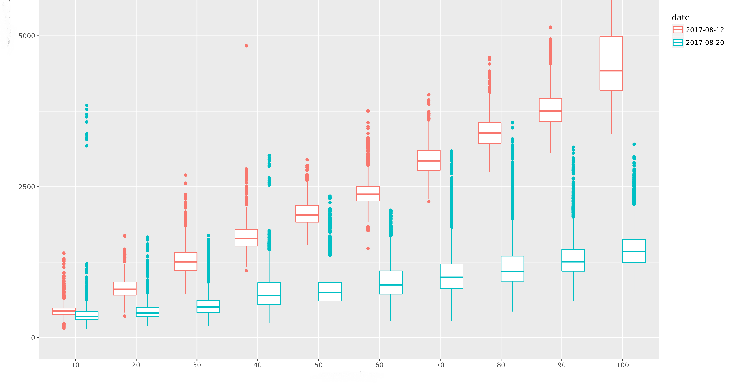
Report generation
500
2500
0
10 20 30 40 50 60 70 80 90 100

Slide 24
Report generation
Based on typical log files reports should be divided on next parts:
Summary report – show only things which go bad
Aggregated report -- describe all measurements with all statistics and graphs
Interactive report – should give full access to all historical data with possibility to compare, filter, split and unite different data types and measurements.
It should be some application with visualization of data
Should provide access to all history of data
Should provide access for all involved person
Should provide export raw data for analysis in external tools
Should be possibility to compare results and measurement between dates, loads, layers and others….

Slide 25
Continuous PT
Report Generation
Machine learning in PT
Recommendation for bottleneck detection
PT fairy fails tales

Slide 26
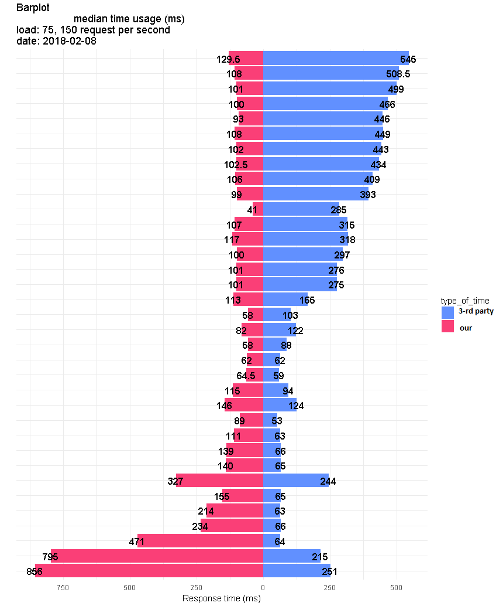
Recommendation for bottleneck detections

Slide 27
Recommendation for bottleneck detections

Slide 28
Recommendation for bottleneck detections

Slide 29
Recommendation for bottleneck detections

Slide 30
Recommendation for bottleneck detections

Slide 31
Why do
all that test?
Old build
New build
Difference
Difference
between builds
COMPARE REPORTS

Slide 32
Recommendation for bottleneck detections
To decrease time for bottleneck detection it is necessary gather information about all layers and all resources.
Next it is necessary build correlation matrix predictor and predicted variables.
Next step it is visualize it in heat map – and it shows what impact more on dependent variable.
It is easiest way to drop all unimportant variables in variety of variables.
For detecting what was changes with previous releases it just needed count differences between previous matrix and newest

Slide 33

Questions
Presentation Here
?

Slide 34
VOTE – what do you want hear next?
Continuous PT
Report Generation
Machine learning in PT
Recommendation for bottleneck detection
PT fairy fails tales

Slide 35
Continuous PT
Report Generation
Machine learning in PT
Recommendation for bottleneck detection
PT fairy fails tales

Slide 36
Performance testing fairy fails tales
Mailing from STAGE environment to real users
Limit connections for TEST environments
Run performance test on TEST environments

Slide 37
Continuous PT
Report Generation
Machine learning in PT
Recommendation for bottleneck detection
PT fairy fails tales

Slide 38
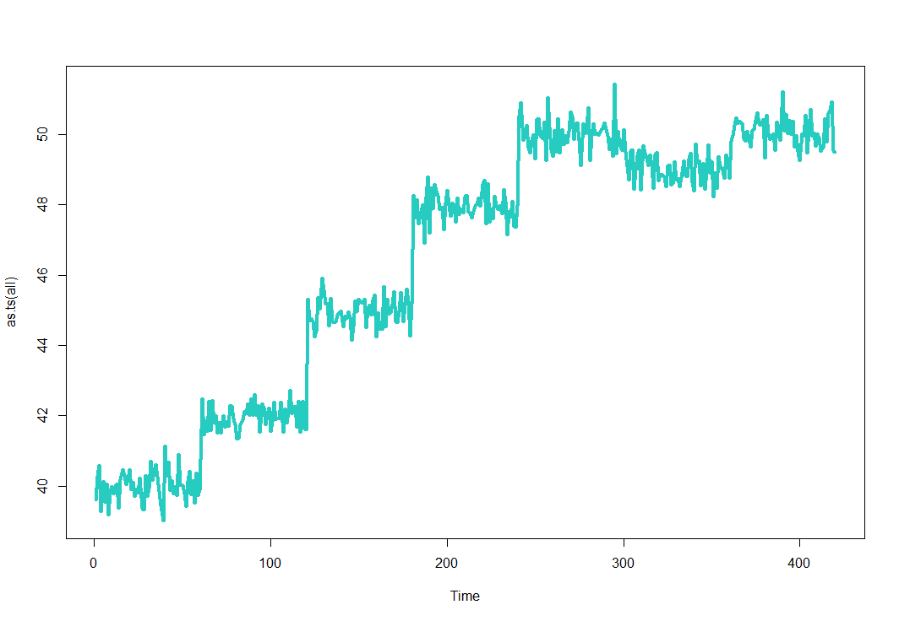
Monitoring resorce log

Slide 39
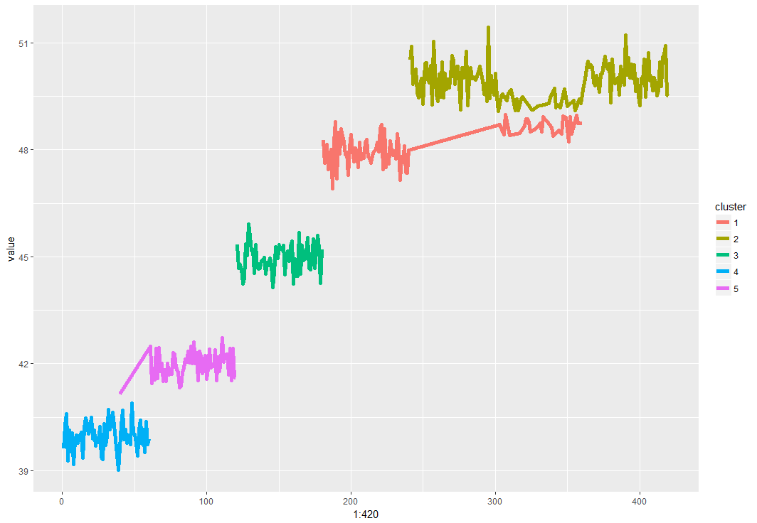
Monitoring resorce log

Slide 40
Machine learning in performance testing
Using clustering in timeseries it is possible to detect bottlenecks-platoe, if plate of resources usage appears before that biggest load in performance tests

